Slide 1
Exploring Computer Vision Preprocessing Techniques For ARMS Plate Imagery Recognition
By: Ryan Yavari, Aditya Nair, and Miles Thames

Slide 2
Introduction

Slide 3
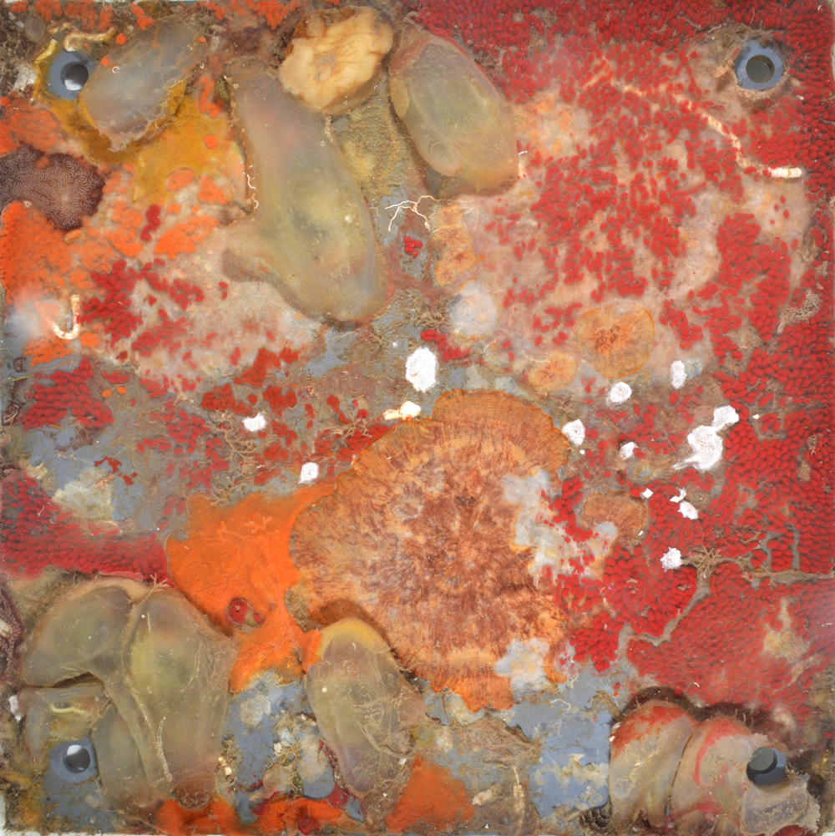
ARMS Plate
We will apply computer vision preprocessing techniques on images of Autonomous Reef Monitoring Structures (ARMS) to help a machine learning model better identify the species inhabiting the plate
Preprocessing Techniques:
Gaussian Blurring
Sobel Edge Detection
Canny Edge Detection
Hough Transform for Circle Detection
Law’s Texture Energy Measures
(Matthieu Leray)

Slide 4
Gaussian Blur

Slide 5
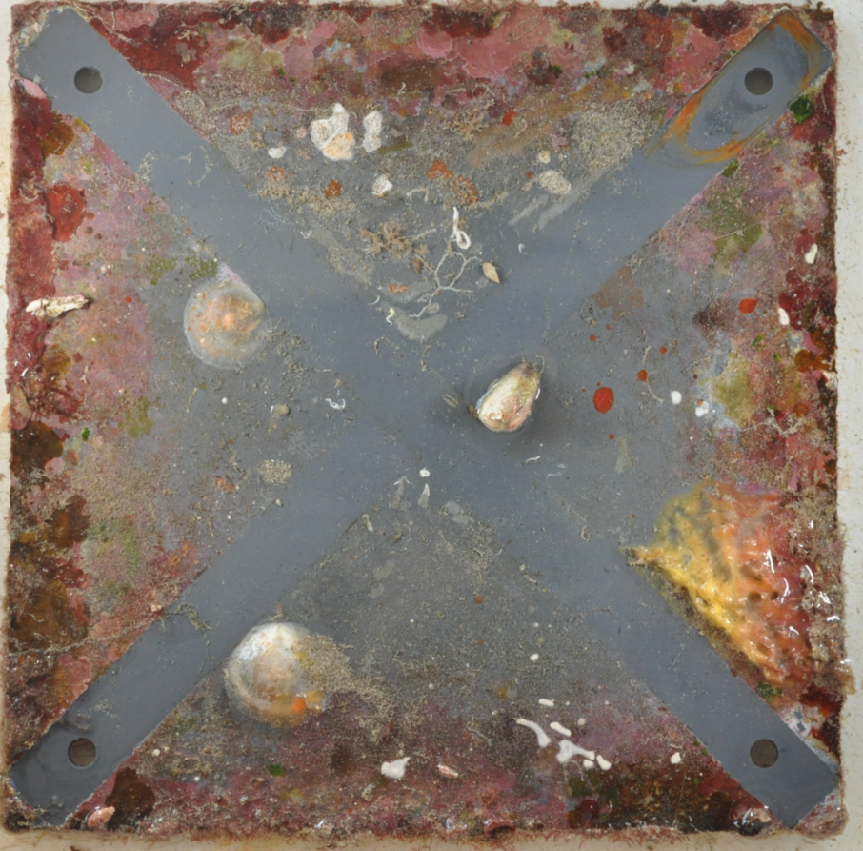
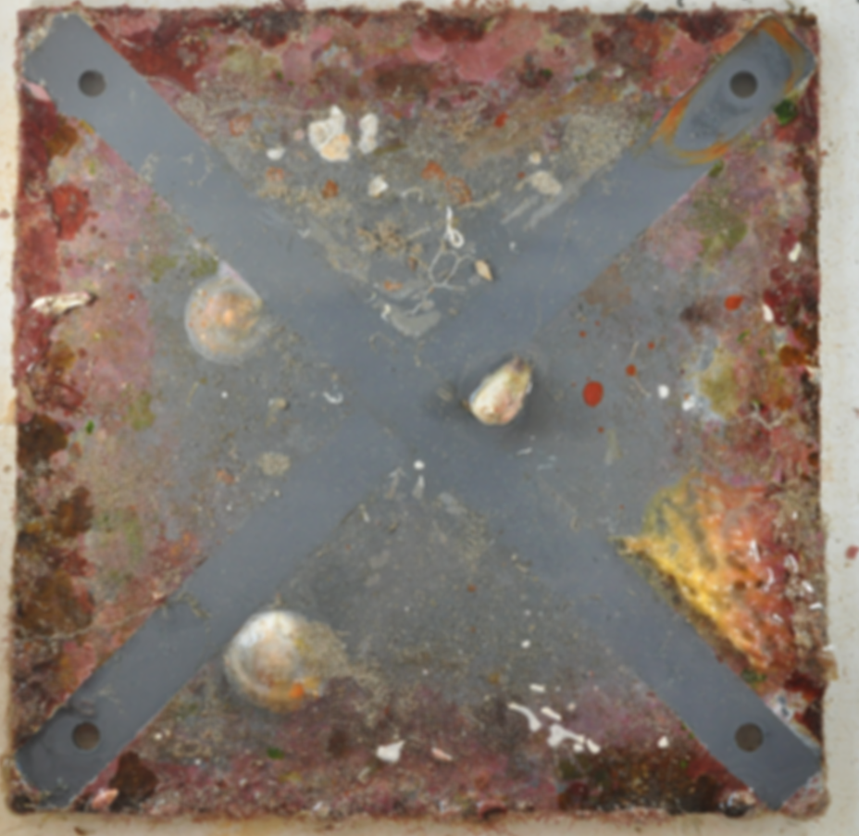
5x5 Gaussian Filter
15x15 Gaussian Filter

Slide 6
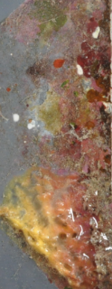
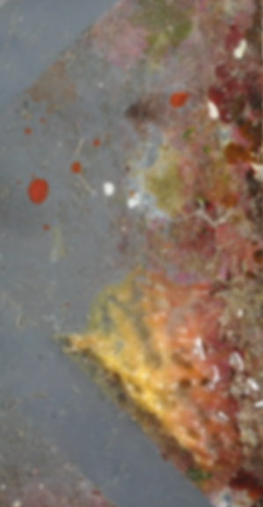
Previous Images Zoomed In
5x5 Gaussian Filter
15x15 Gaussian Filter

Slide 7
Analysis on Gaussian Blur
When comparing a 5x5 Gaussian Filter with a 15x15 Gaussian Filter, we can see an increased intensity of Gaussian blur on the image as the filter increases in size. However due to the large magnitude of the image, the increased intensities of Gaussian blur in respect to increases in the filter size are subtle until the image is zoomed into. As the filter intensity increases, the ARMS plates increasingly lose their texture and miniscule detail.

Slide 8
Sobel

Slide 9
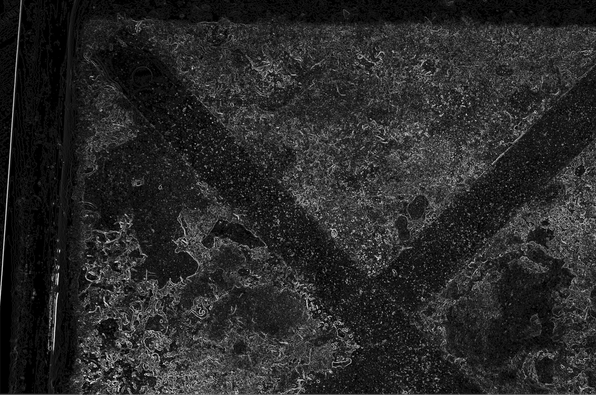
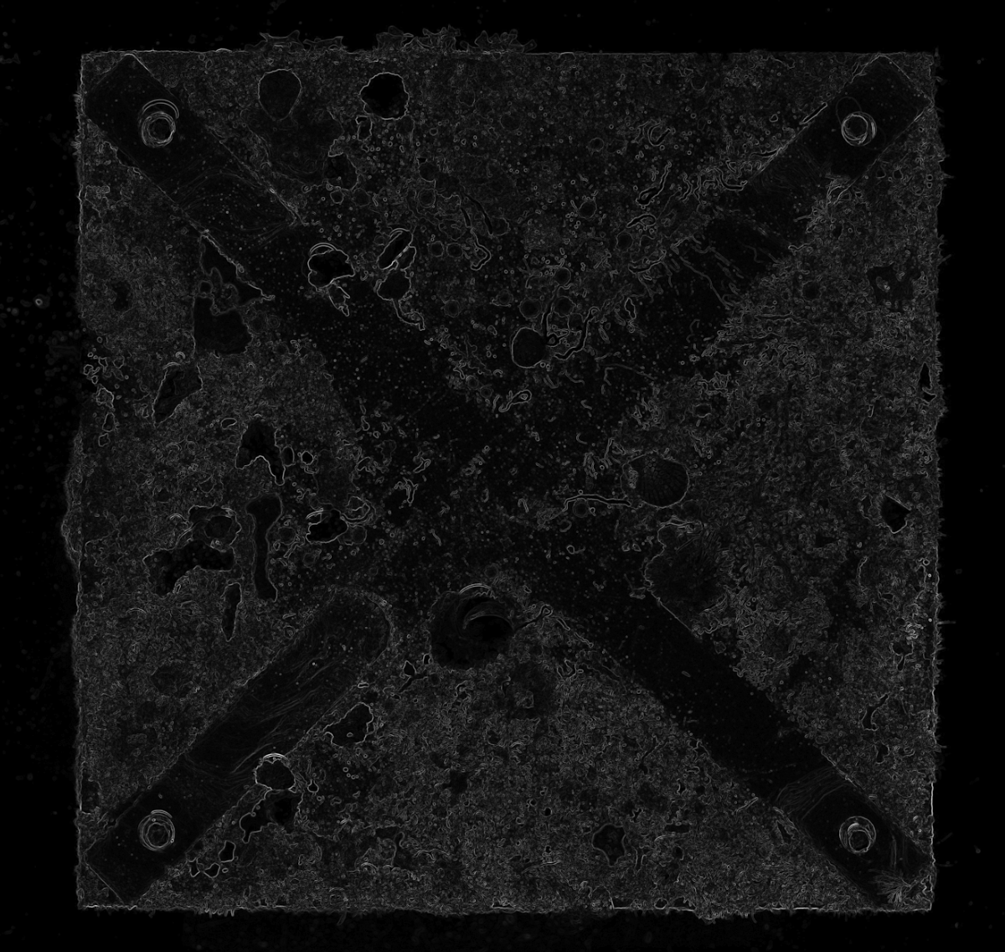
Sobel with C Sobel with OpenCV
(high derivative)

Slide 10
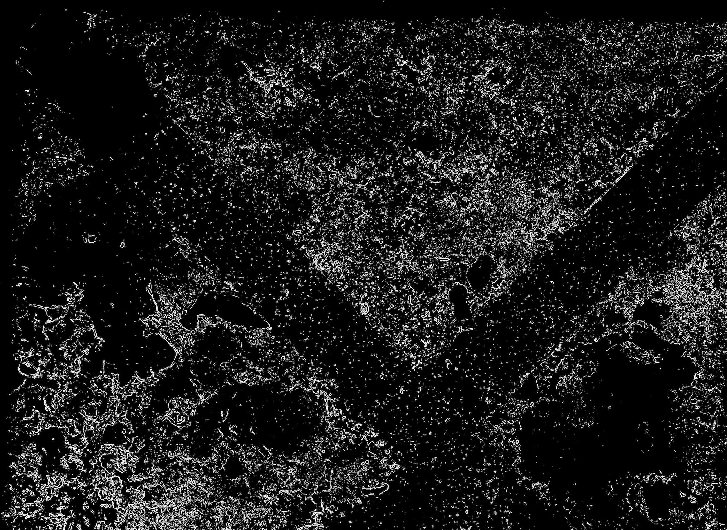
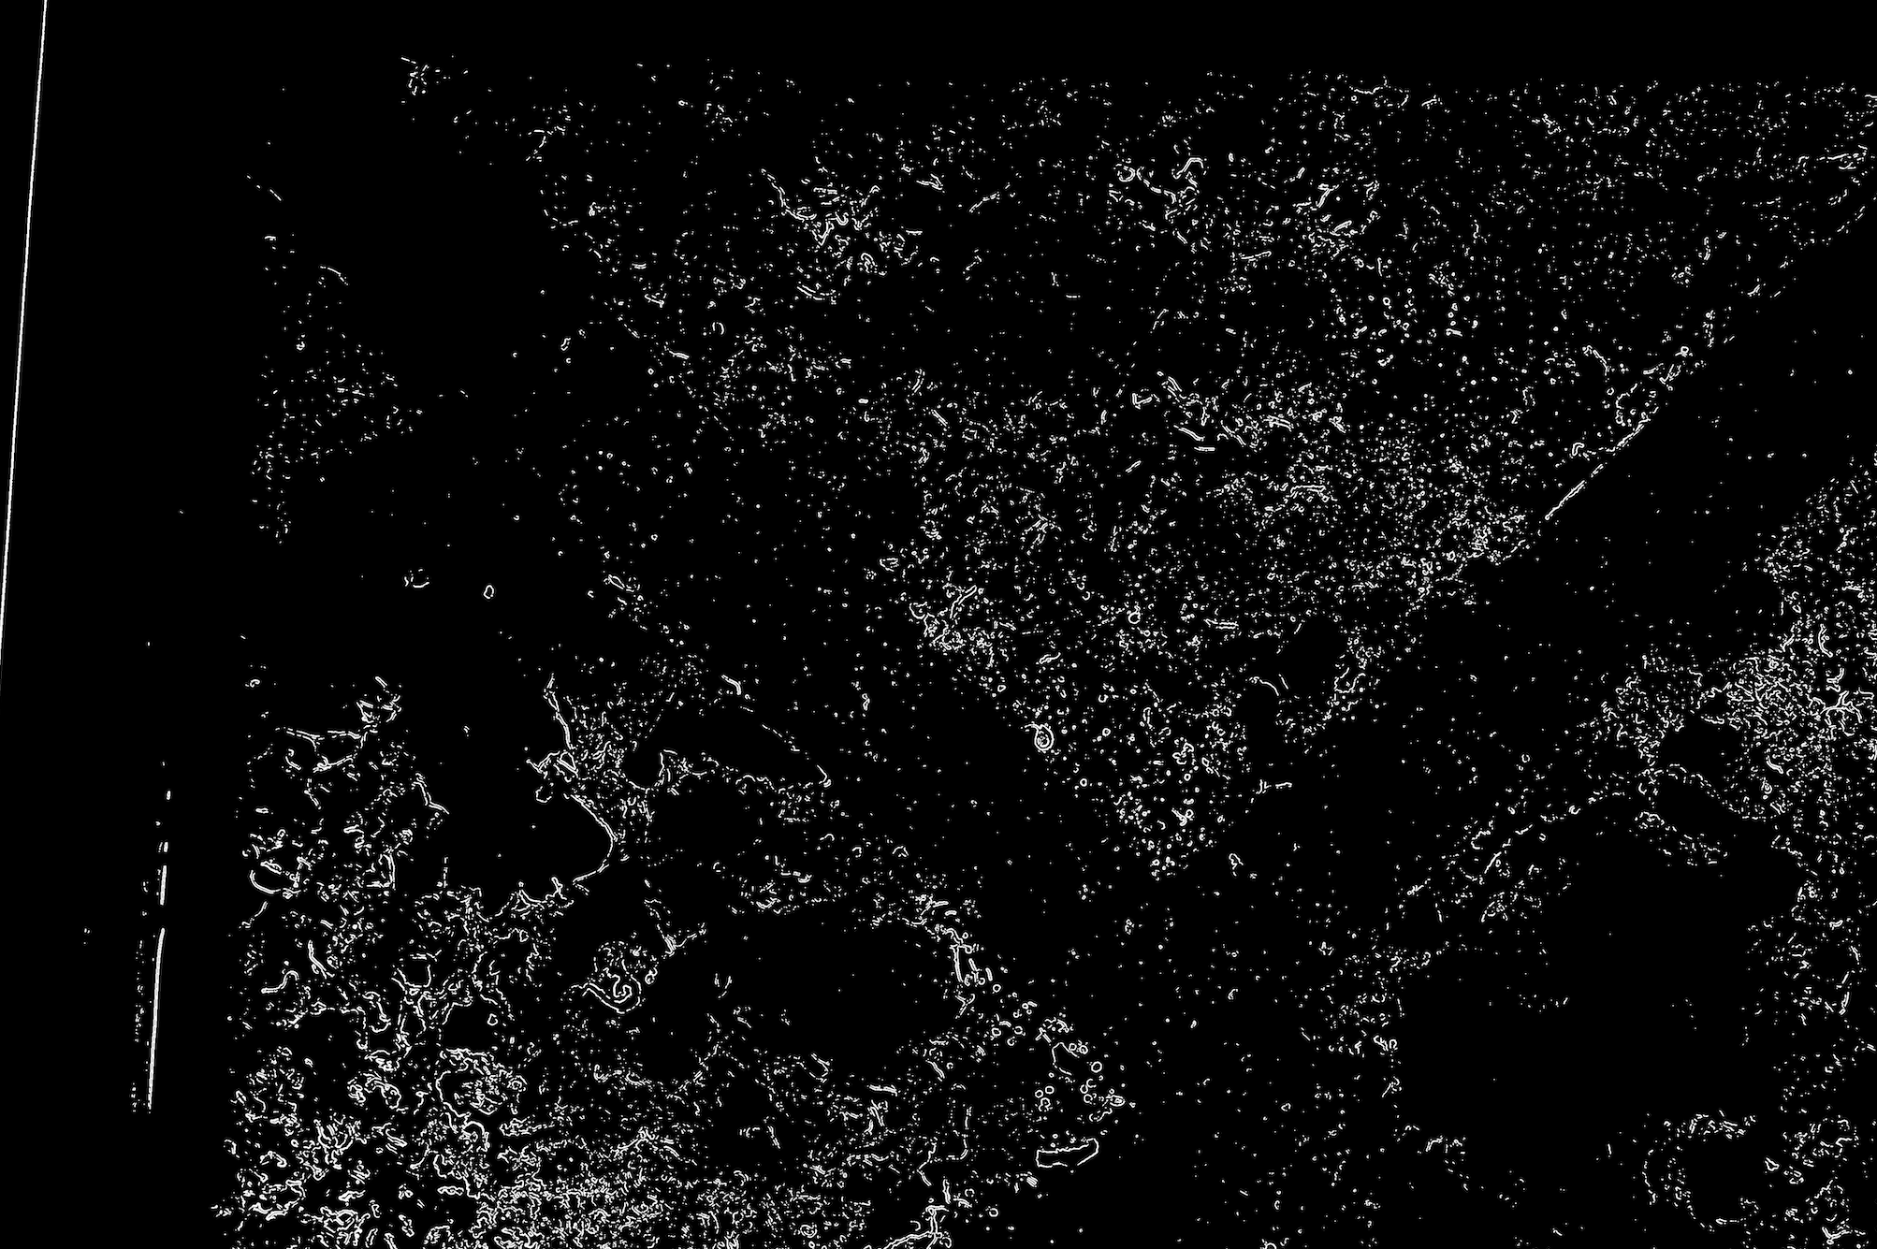
Experimenting with Improving Sobel
Convert to B/W, Shrink/Expand to eliminate noise
Loses too much useful information

Slide 11
Canny

Slide 12
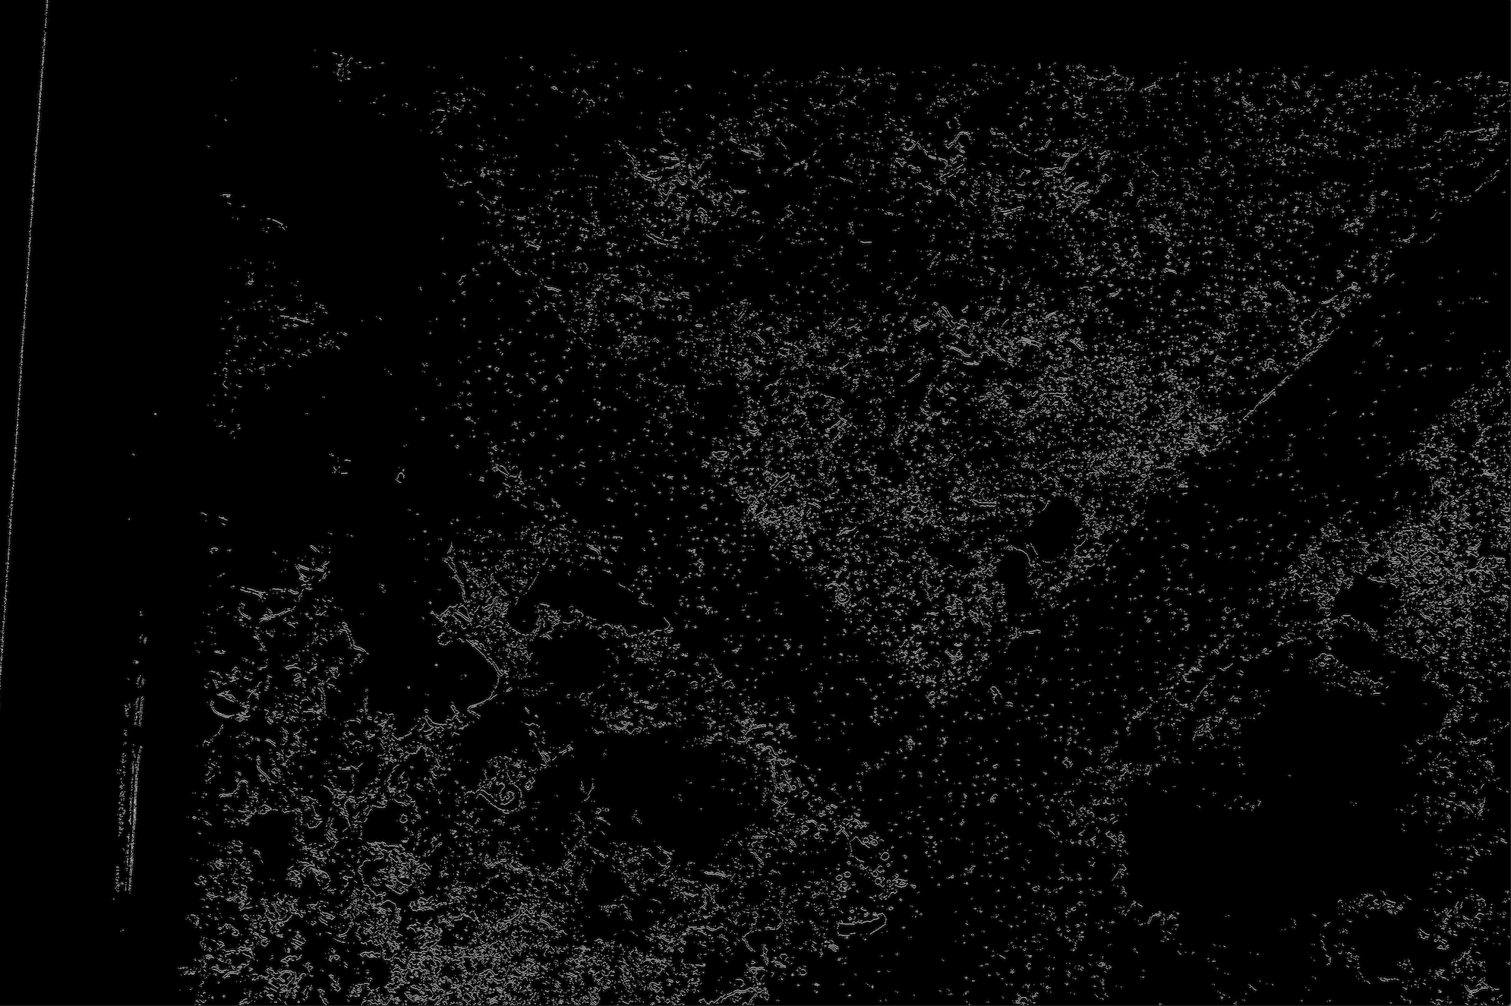
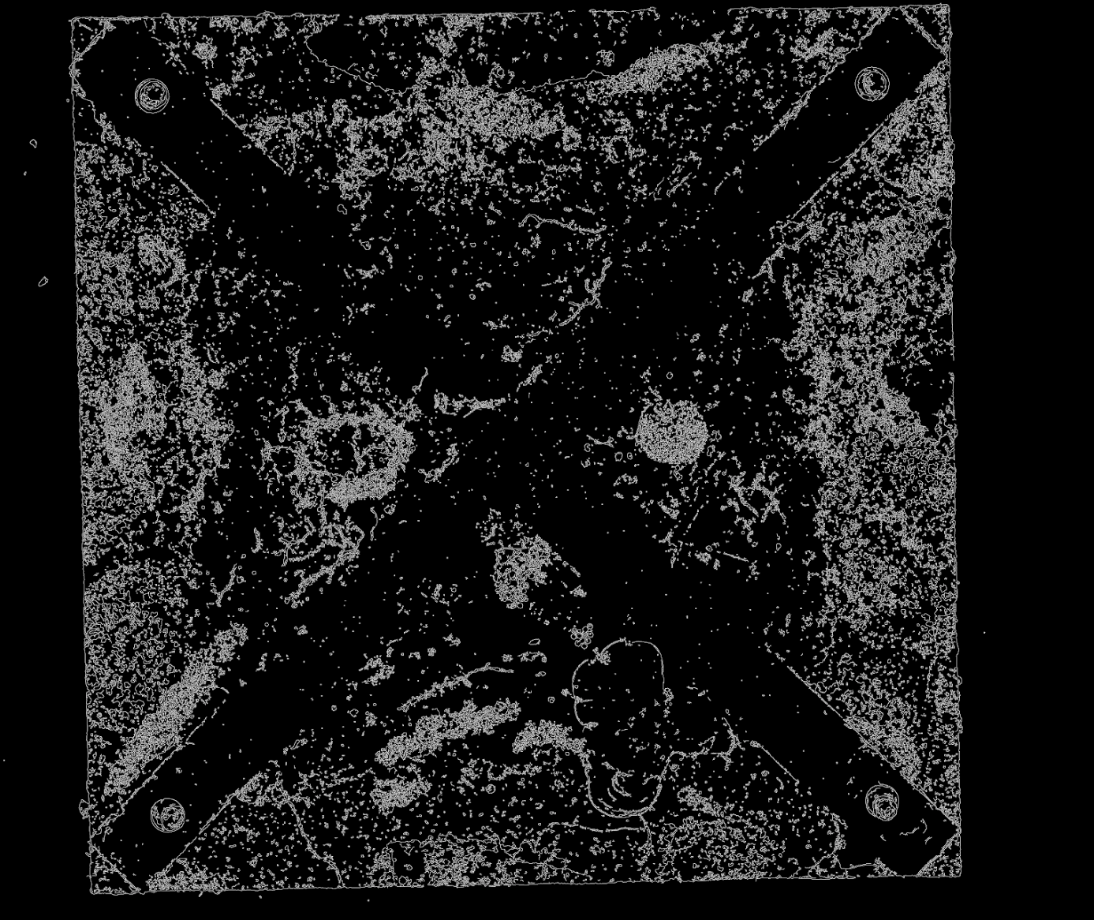
Canny with C Canny with OpenCV
Low threshold leads to missing key features, high Threshold leads to high noise

Slide 13
Analysis on Sobel and Canny
Sobel filters do a great job at finding edges of objects on the plate, and the algorithm is highly customizable using the derivative to show more or less edges. Sobel can also be normalized to get consistent intensity levels of the output image. For these reasons, Sobel would likely be a great option to feed into the model for a more accurate result.
Canny filter seems to be very noisy. Low thresholds leads to missing key features, while high Threshold leads to this increased noise. For these reasons, Canny might not be the best option to feed into a model, as there might be a lot of distracting data.

Slide 14
Hough

Slide 15
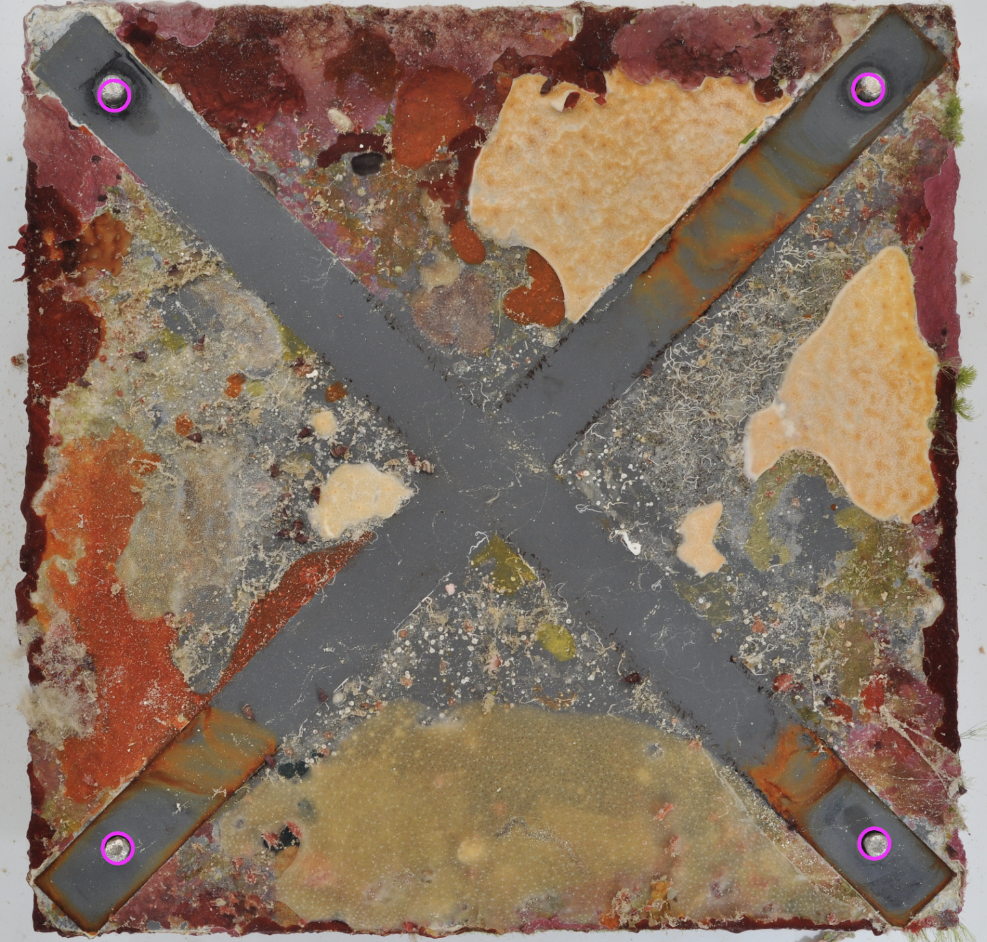
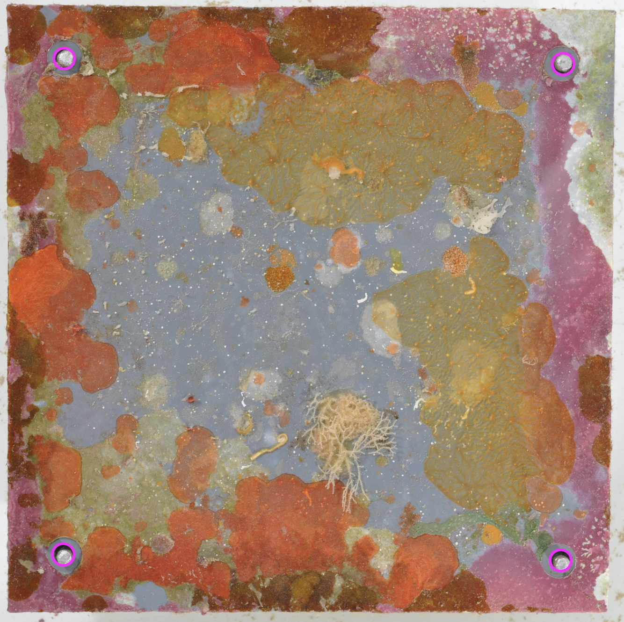
Successful Screw Detection

Slide 16
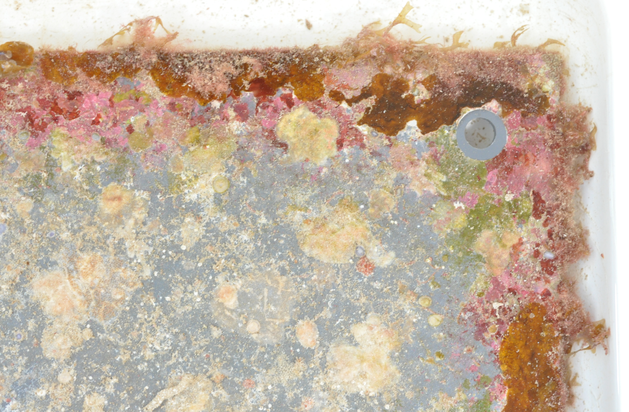
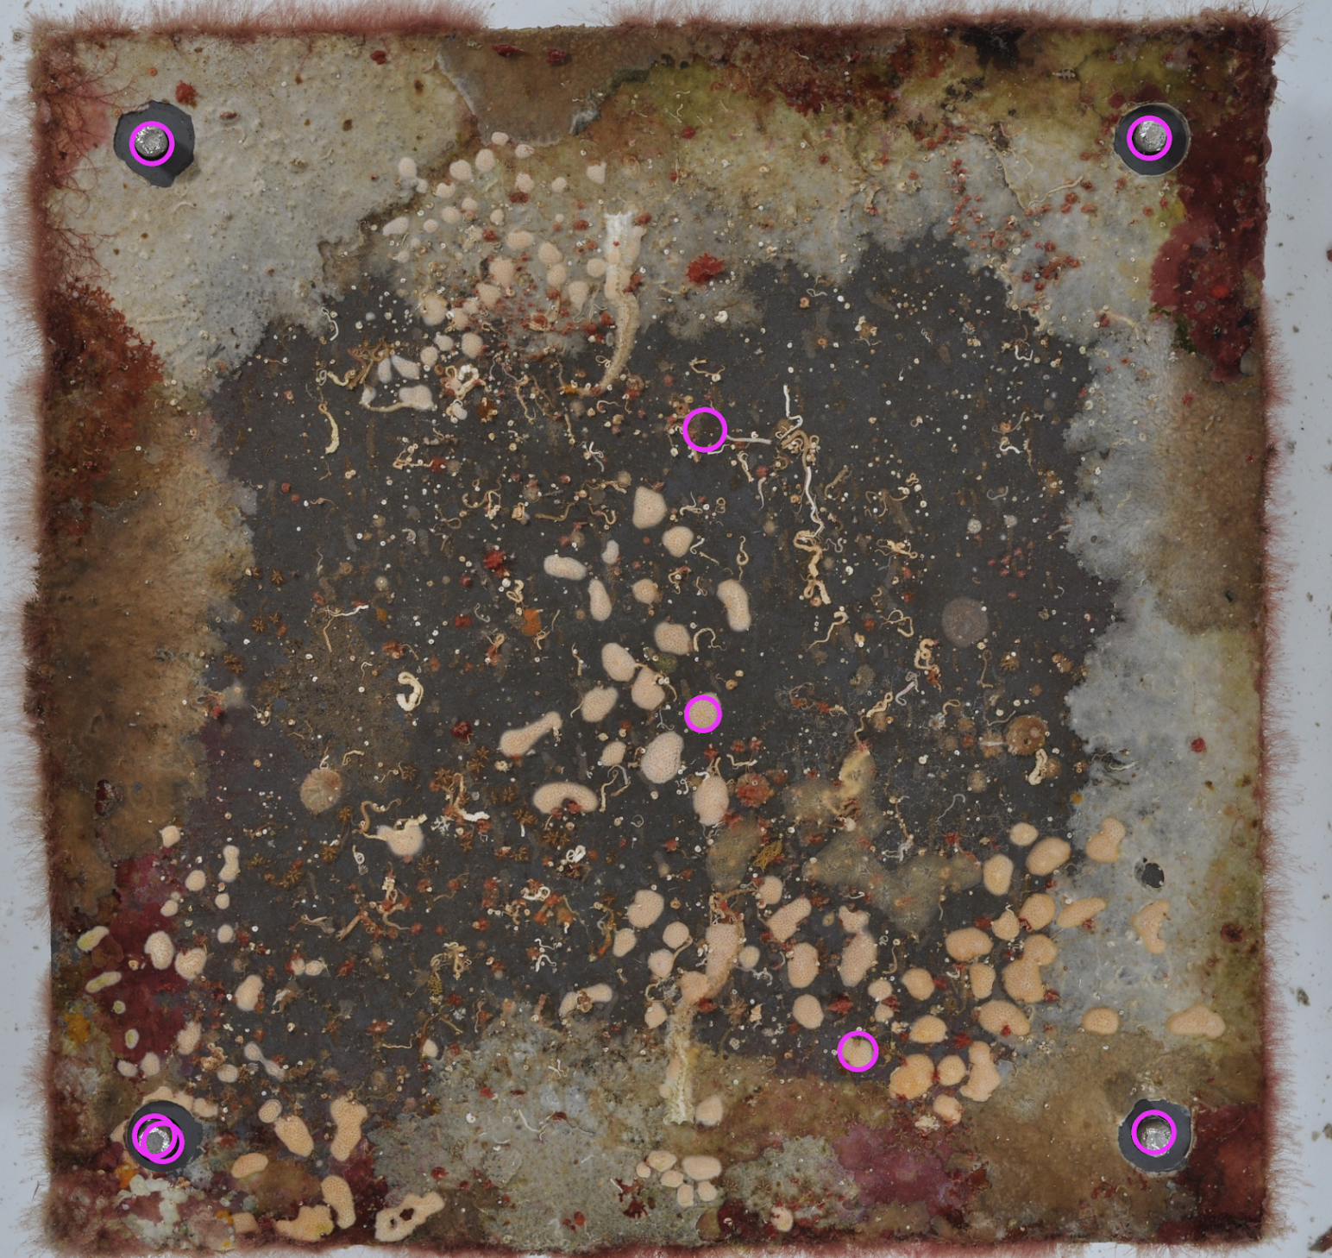
Poor Screw Detection

Slide 17
Analysis on Hough Transform
By fine tuning the filter’s maxRadius and minRadius, Hough transform did a great job on detecting screws in images where the screw radius was known. For most of the entries in the dataset, we found that screw detection was most accurate when fine-tuning the following variables: minRadius = 35, maxRadius = 45.
Poor screw detection occurred when dealing with images in the dataset that had inconsistent screw radiuses from other samples. For example, the previous slide image is a blown up corner of a full ARMS plate. With the image being blown up, the radius is abnormally large and outside of the maximum radius that the Hough Transform can detect. Another instance of poor screw detection occurred when the Hough Transform would pick up circular sponges with radiuses that were within the threshold, as seen in the previous slide.

Slide 18
Law’s Filters with K-Clustering

Slide 19
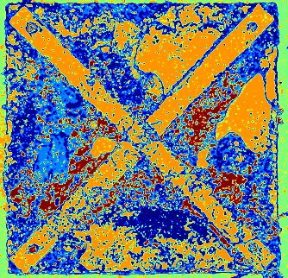
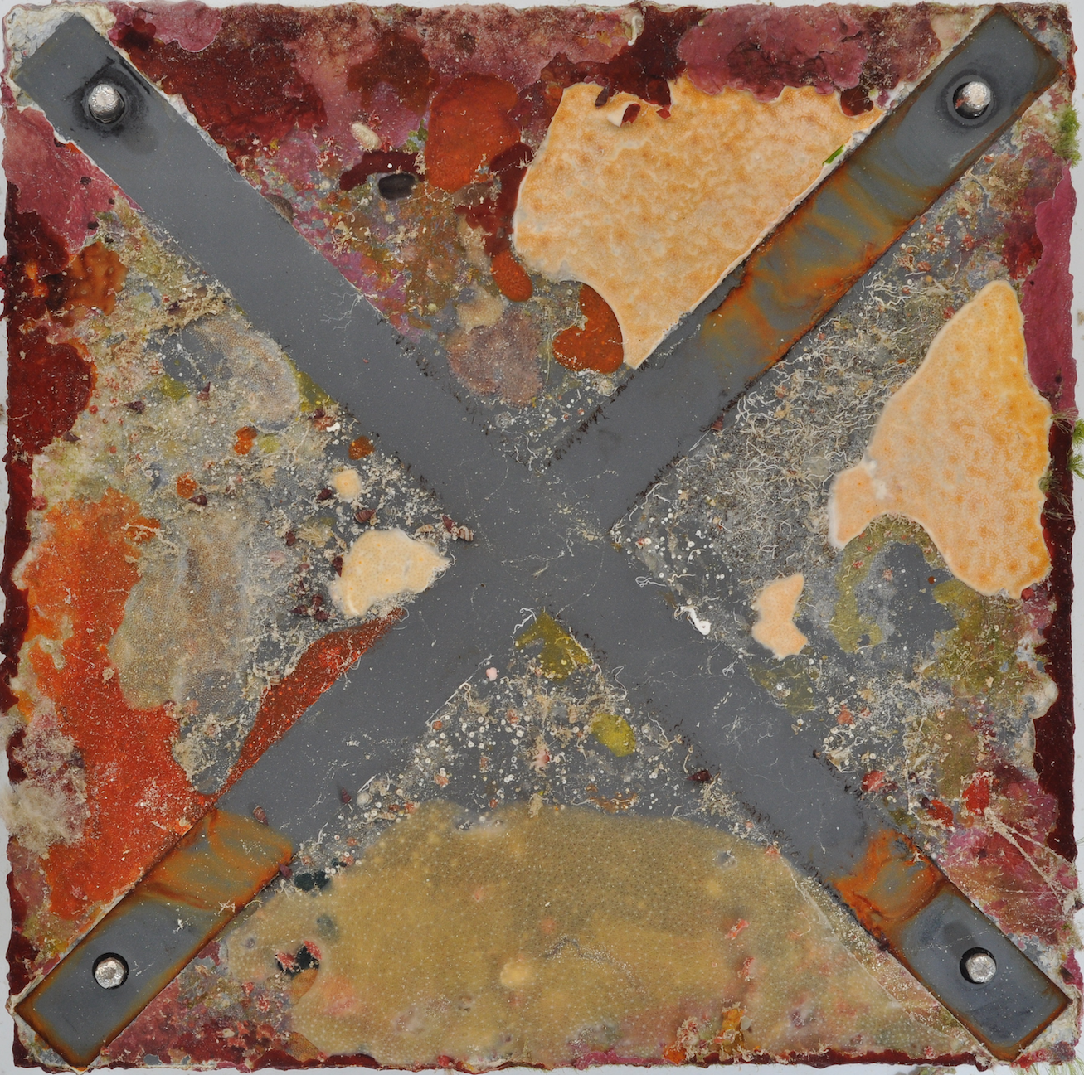
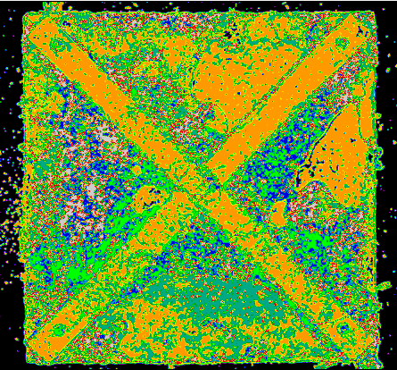
5 Textures
Window size 10
Original
6 Textures
Window size 15
Law’s Texture Energy Measure seems to conflate the ‘x’ texture of the plate and the white sponge.
In both of these cases, the segmentation gives a unique color to the grey around the center, but it is unable to apply it to the ‘x’ region of the plate
Besides the color assignment, the boundaries for the textures are well defined

Slide 20
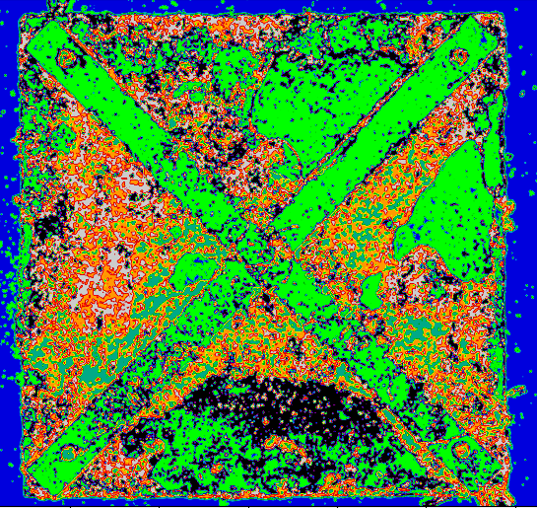
laws texture_count 6
window_size 15
Law’s Texture Energy Measures work with texture information independent of color. To have it ‘account’ for color, we can split the image into color channels and run the energy measures on them independently. Then we can concatenate the feature vectors from each channel and use the larger feature vectors for clustering.
Despite the addition of this color data, the results are very similar. There is slight improvement of segmentation in finer regions around the ‘X’, but the white sponge and the plate are still classified the same
laws_color
texture_count 7
window_size 3

Slide 21
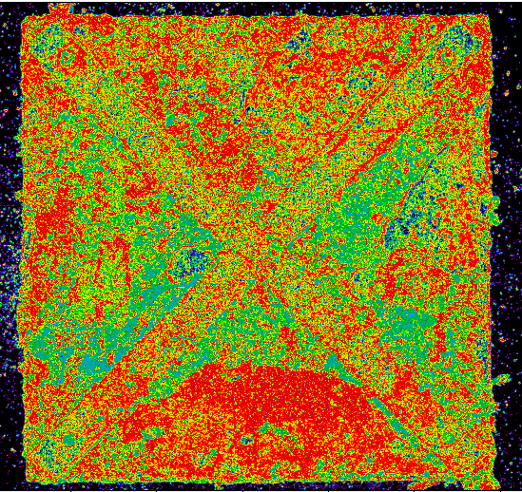
In an attempt to separate the ‘X’ and white sponge textures we adjusted the texture count and window size of the Law’s Color function to create a detailed distinction between the regions.
This resulted in a noisy image worse than before
laws_color texture_count 7
window_size 3

Slide 22
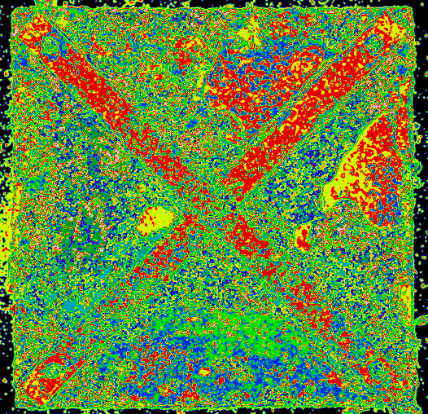
laws texture_count 10
window_size 15
Some distinction between the ‘X’ and white sponge was made with the original laws function and higher texture count

Slide 23
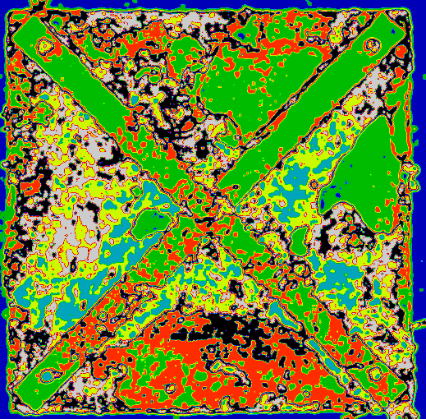
Our Law’s function seems unable to differentiate between the smoothness of the ‘X’ portion of the plate, and the smooth portion of the white sponge.
Despite that, there is clear definition between the sponges and and other algae/life on the surface of the plates. Which should help the model
Another texture segmentation method like GLCM might be better at distinguishing between the smooth textures and may benefit more from the addition of color

Slide 24
Conclusion
After the application of our preprocessing techniques, it is clear that they facilitated the distinction between different species through their edges and textures. Our Hough transform was able to identify the screws in the plate effectively.
It is anticipated that the refined images as input to the model will should improve the results
See our Results and Source Code

